Slide 1
Worcestershire County Council Pension Fund

Slide 2

Aims and purpose of the Scheme
The aims of the Scheme are to:
 | enable employer contribution rates to be kept as nearly constant as possible and at reasonable cost to the taxpayers, scheduled, designated, community and admitted bodies
 | manage employers’ liabilities effectively
 | ensure that sufficient resources are available to meet all liabilities as they fall due, and
 | maximise the returns from investments within reasonable risk parameters
The purpose of the Scheme is to:
 | receive monies in respect of contributions, transfer values and investment income, and
 | pay out monies in respect of scheme benefits, transfer values, costs, charges and expenses

Slide 3
The Fund’s membership profile

Slide 5
Surplus / (Deficit) cash for investment (excluding investment income)
 | 2011/12 | 2012/13 | 2013/14 | 2014/15 | 2015/16
 | £m | £m | £m | £m | £m
Net surplus cash for investment | 2.8 | (2.1) | (-1.2) | (51.9)* | 0.5
* A group transfer out of the Probation Service to the Greater Manchester Pension Fund of £52.3million took place in February 2015 due to the national restructuring of the National Offender Management Service.

Slide 7
Distribution of the fund's assets as at 31 March 2016

Slide 8
Geographical Spread of Investments (excluding cash, derivatives and global 'Alternative Indices' passive pooled investments)

Slide 9
The Fund’s current asset classes
• Equities
• Bonds
• Property
• Infrastructure
• Cash

Slide 10
Proportion of the market value of investment assets held by the external fund managers at the year-end

Slide 11
Investment Mandates
- Active / Passive
- Indices
- Active targets
- Investment guidelines and restrictions
- Investment management fees
- Transaction costs
- Risk measurement
- Performance measurement
- Proxy voting

Slide 12
Global Custodian – BNY Mellon
- safekeeping assets/securities
- settlement of purchases and sales
- collect income from assets e.g. dividends
- administer corporate actions
- maintain currency/cash bank accounts
- perform foreign exchange transactions
- fund accounting
- stock lending

Slide 13
LGPS Central – Asset Pooling
• LGPS Central is being created because of government policy, to generate savings in investment management fees without compromising performance
• Crucially, the government expects pooled LGPS investment within a regulated environment
• The government expects the regulated pools to be established by 1st April 2018

Slide 14
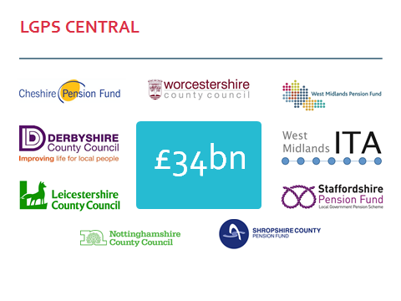

Slide 15
2016 ACTUARIAL VALUATION
KEY THEMES
The main purpose of the actuarial valuation is to review the Fund’s progress against its funding objective. This involves comparing the expected cost of providing the benefits already built up with the Fund’s assets, and making plans to recover any deficit; as well as working out the future contributions needed to cover the cost of the future benefits and other costs incurred in running the Fund.
The valuation also represents an opportunity for the Authority to consider their medium to long-term objectives for the Fund and to put in place ways of monitoring progress against these objectives, as well as agreeing triggers for further action or discussion.

Slide 16
Solvency Funding Position

Slide 17
Reasons for Change in Funding Position Since the 2013 Actuarial Valuation

Slide 18
Pension Fund Governance Structure

Slide 19
Opportunities to get involved with the management of the Pension Fund
• Pension Committee – next meeting 16/06/2017
- Contact Cllr. B. Banks (Chairman)
- Contact Sean Pearce (Chief Financial Officer)
• Pension Investment Advisory Panel
• Pension Administration Advisory Forum

