Slide 1

Designated Teacher
Updates and Guidance Session
Autumn 2025

Slide 2
Agenda
Language that Cares; writing the PEP to the child/young person – Kerry Lawrence, VSDHT
Christmas in the Classroom– Mary Williams, WVS SEND Lead
Safeguarding update – Sadie Holloway, WVS DSL
PEP Updates and questions – Paula Hemming, WVS Learning Advocate

Slide 3
Person centered approach to recording on the PEP document
Who is the PEP for?
Worcestershire Virtual School
9th December 2025

Slide 4

Slide 2
Rebekah Pierre – An open letter to the social worker who wrote my case files

Slide 5
Rebekah Pierre – An open letter to the social worker who wrote my case files
Rebekah Pierre (Social worker and BASW PO) requested her care-files, and was shocked by what they contained. The below open letter was penned as a call to action, and to raise awareness about the importance of kind, caring and accurate case records, as part of National Care Leavers Week 2022.
Trigger Warning - contains extracts of case notes some may find upsetting, with reference to CSE & domestic abuse.

Slide 6
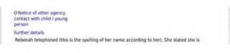
Dear tara
Dear Tara*,
Before I wrote this letter, I double checked the spelling of your name just to make sure it was correct. I know how jarring it can be when the basics are not quite right; you misspelt my name almost one hundred times in the case files you wrote about me whilst I was under your care. I received these last week, after submitting an SAR request to the relevant local authority.
Speaking of names, let me remind you of mine. My name is Rebekah. It is the Hebrew spelling, and I am quite fond of it. It may sound like a small detail to some, but to me, it matters. It is the name I was given when I was born.
Case Note 1
I once corrected the spelling, as you can see in Case Note 1. But it never was changed on the system. Instead, a rather blunt note was written to say ‘this is the spelling of her name according to her’ (for the record, I wasn’t lying). This was just one of many examples where I was not believed.
I don’t know if my name rings a bell - but even if it does, you probably wouldn’t recognise me now. You were involved in my life at a time I was extremely vulnerable and on the verge of being homeless - a 16-year-old girl with everything to live for, who didn’t have much interest in living at all.

Slide 7
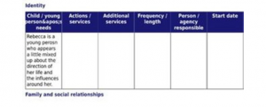
Case note 2
Case note 2
Since that time, much has changed; despite being a ‘young person who is a little mixed up about the direction of her life’ (your words - see case note 2), I ended up following in your footsteps. I wanted to be like the residential social worker I had after you, who practised with care, kindness and compassion. I have since had the privilege of practising alongside many such practitioners, who transform lives every day. On reflection, perhaps I wasn’t so ‘mixed up’ about the direction of my life after all?
During my career, I have read case notes of varying quality. Most have been child-centred and thorough. Others have not. But for all I have read, nothing could have prepared me for reading my own records - particularly the entries written by you.
To give you the benefit of the doubt, I imagine you have changed since writing these records. Your approach may well be unrecognisable now; it is why I took the time to write this letter. I have some small faith that this time, you will hear me. I hope in earnest that you will.

Slide 8
Case note cont
I cannot pretend my recording is perfect. I know how hard it is to write good case notes whilst balancing competing deadlines and crises. But I have always done my utmost to be respectful - to write with the child in mind.
In your defence, I don’t think I was the audience you had in mind when you wrote them, was I? Perhaps you saw the screen in front of you as the final destination. It was not; your words, written about but without me, would not remain hidden forever. One day, I would understand my rights.
Speaking of rights, do you remember taking me to an Achieving Best Evidence interview after school, where I had to disclose the most traumatic events of my life to yourself and a police officer? It was my right to have an advocate - something I only learned years later.
It took all the strength I had to get through those 4 hours, with no emotional support or break. I have never felt so small, so humiliated. Looking back, it was like an inquisition. Like somehow, I was the one on trial. Now it is my turn to ask the questions.
The first is this; how dare you?

Slide 9
Case note 2 cont
It is too late to go back in time. But it is not too late to make a meaningful change for other children. May your words be worthy of each of them. Who knows, one day, you may find yourself reading what they grow up to write about you.
Yours,
Rebekah (with a k)
There are 5 further case notes identified – a full copy will be provided.

Slide 10
School records and reports
Do you remember your school records / reports?
What was said about you? Was it correct?
Was it positive?
How did you feel reading your school report?
Is there a particular phrase that sticks in your head?

Slide 11
Case study
She is a very quiet, helpful child.
XXXX has produced work of a quite good standard. Her experimental reports are now clear and accurate. The recent test score of 74% (average 56%) indicates a clear potential in the subject.

Slide 12
PEP comments
The pupil displays signs of emotional dysregulation during core subjects, particularly Mathematics and English, which can affect concentration and participation.
What is going well for me? What my Key Person/DT/Early Years Lead thinks - There have been some concerns for XXXX behaviour and presentation since moving placement. She has started to truant again and most days will arrive late and miss form. She has developed a care free attitude towards school and has stated she 'doesn't care' about school and no longer wants to do well. Makes several attempts to try and go home throughout the day. Believe this is to spend time with her friend outside of school. XXXX has missed a total of 51 hours due to truanting/absence. Behaviour has got worse culminating in a fight with another student resulting in suspension.
XXXX has been at significant risk of suspension because of his emotional dysregulation and the part time timetable is supporting his emotional wellbeing. He has been violent towards members of staff and other children. It is planned to increase his timetable this term provided that he remains calm and his behaviour is safe.

Slide 13
Personal Education Plans
What are they for? What happens to them?
Young people choose to access their care records for a number of reasons – the most common being that they are looking for answers.
For young people in care, a lot of decisions are made for them without them understanding why.
“You realise there’s recording taking place about you every single day, as a young person growing up in care, you can often feel judged and stigmatised, and I, personally, had a big lack of trust. I always thought that everybody thought the worst of me. Accessing your records can answer some of these questions.” Luke Rogers

Slide 14
Writing for the young person
Think about what would the world look like if at any point a child in care could access their records in real time.
“Imagine, at any point, the young person that you’re working with can log on to their computer and read what you’re writing about them, how that would influence your behaviour. What does that do for our accountability?” Luke Rogers
Task:
Write the ‘school views’ section of the PEP (for a young person you are supporting).

Slide 15
Writing for a young person
1. XXXX has been awarded an EHCP. Primarily for SEMH support. This is a high level matrix, which reflects the high levels of adult support required to support XXXX to go into lessons. Since September, XXXX has been much more settled and has attended most lessons and adhered to the routine of a safe space and emotional check in with an adult if she felt overwhelmed. Recently there has been more resistance to this, which has coincided with the anniversary of her Nan's death. We have seen a sharp rise in the number of lessons XXXX refuses to go into. She is unwilling to discuss her recent bereavements and emotions in school. This is something we feel that needs to be addressed immediately in order to support her own mental health and wellbeing.
2. In lessons, XXXX can also be somewhat oppositional at times. She has support in 90% of her timetabled lessons, sometimes with 2 additional adults within the room and these adults are all trained in averting oppositional behaviours. We are trying to be firm with XXXX as we feel that if there is a grey area, XXXX can try to overcome this an impose her own rules and expectations.
3. XXXX is particularly opting out of PSHE lessons. Some of the content may trigger her and a pastoral approach is used. The intention is to pre warn XXXX so she can be somewhat prepared for the lessons. It is important that she attends so that she can be educated on themes like consent.
4. I would like to highlight her mobile phone use in school - she struggles to stay off her phone.

Slide 16

Any Questions?
Any questions?

Slide 17
Kerry lawrence
Kerry Lawrence
Deputy Head Virtual School
Tel: 07534 098035
Email: klawrence5@worcestershire.gov.uk

Slide 18


Christmas in the Classroom:
Kerry Lawrence
Deputy Head Virtual School
Tel: 07534 098035
Email: klawrence5@worcestershire.gov.uk
A Trauma-Informed Guide to Supporting Children in Care
November 2025
Wolverhampton Educational Psychology Service
Wolverhampton Virtual School

Slide 19
Christmas in the classroom
The festive season whilst joyful for many, can be a complex and emotionally charged time for children in care. Schools play a vital role in creating inclusive, supportive environments, especially during periods that highlight family, tradition, and belonging. For children who have experienced trauma, loss, or instability, Christmas can bring feelings of grief, anxiety, or isolation rather than celebration. This guide offers practical, trauma-informed strategies to help school staff navigate the season with sensitivity—ensuring that every child feels safe, seen, and supported during this time of year.
Why It Matters: What the Research Tells Us
Christmas is often framed as a time of warmth, family, and joy—but for many children in care, it can be a stark reminder of what they’ve lost or never had. It’s a season that can magnify feelings of disconnection, loneliness, and emotional vulnerability. And critically, the evidence shows that this isn’t just a theory — it’s a lived reality for thousands of children.
Between 18 December and 3 January, an average of 79 children in care in England are moved to a new home every day (Become, 2023).
In that same period, almost 900 children enter care for the first time, many experiencing Christmas away from familiar people and surroundings.
Over 28% of those moved during the festive period are relocated more than 20 miles away, separating them from peers, schools, and support systems.
Children who experience frequent home changes are more than twice as likely to develop serious mental health issues, including anxiety, self-harm, and PTSD (University of Bath, 2022).
And yet — for many — school is the one consistent environment they return to after the holidays. That makes your role as school staff deeply meaningful.
“During the holidays, the people we rely on — our teachers and school staff — disappear. It’s the
loneliest time of year.”
— Care-experienced young person, Become Charity, 2023
For some children, Christmas means family traditions, gifts, and laughter. For others, it may bring memories of loss, instability, or trauma. This contrast can be painful — especially in school settings where festive activities unintentionally highlight what some children are missing.

Slide 20

Christmas in the classroom
Why this matters in schools
Children in care may return to school in January having experienced another home move — or even entered care for the first time. For some, the festive period may have been marked by instability, emotional upheaval, or feelings of isolation.
Christmas in schools is often framed as a joyful, family-oriented time — but for children in care, it can be complex and painful. Festive activities can unintentionally exclude, overwhelm, or trigger those navigating grief, trauma, or instability. Songs, smells, stories, or assignments like “write about your family traditions” may serve as painful reminders of what’s been lost — or what’s never existed.
For many children in care, school is the most consistent and emotionally safe place they have. Teachers and support staff often serve as key adults in a child’s life. Your approach over this period can offer something vital: stability, kindness, and psychological safety.
Children impacted by trauma tend to thrive in environments where things are predictable and consistent. The festive season, with all its changes to routines, unfamiliar events, and sensory overload, can be dysregulating — unless carefully planned for.
Not all children celebrate Christmas. For some, it’s tied to feelings of exclusion, neglect, or abandonment. Trauma-aware practices help avoid unintentional emotional harm and instead promote inclusion, safety, and connection.

Slide 21

Christmas in the classroom 1
Key Message:
Children in care don’t need pity — they need predictability, connection, and empowerment. Schools are uniquely placed to provide this.
This is more than “being nice at Christmas.” It’s about recognising the emotional complexity this season
can bring — and responding with empathy, structure, and intentional inclusion.
You might be the most stable adult in a child’s world. Your presence, your language, and your planning
can offer moments of healing, dignity, and hope — in a season that doesn’t feel bright for everyone.

Slide 22

Christmas in the classroom 2
Putting Trauma Informed Practice into Action at Christmas
Christmas doesn’t need to be cancelled. But it does need to be approached with care, flexibility, and awareness that not every child finds this time easy. Here’s how schools can build safe, inclusive environments during the festive period — especially for those who may be carrying more than they show.
Be Predictable: Routine is a source of safety
Many children in care have experienced environments where routines were unpredictable or unsafe.
Let children know in advance what will happen — use visual timetables, class calendars, or verbal reminders.
Keep the classroom structure familiar where possible — even small disruptions (e.g. parties, visitors, decorations) can cause anxiety if unexpected.
“Predictability helps a traumatised brain feel safe.”
Be Flexible: Not everyone will want to join in
Give children clear permission to opt out of Christmas activities without drawing attention to them.
Avoid forced participation in anything family-focused (e.g. "Write about your Christmas morning").
Provide quiet alternatives during whole-school events — a reading nook, mindfulness time, or helping with a classroom task can be a dignified way to opt out.
Be Inclusive: Avoid assumptions about home and family
Not every child will spend Christmas with “mum and dad” — or even in the same home from one week to the next.
Use language like:
  “What are you looking forward to over the break?” instead of “What’s your family doing for Christmas?”
  “Who would you like to make a card for?” rather than “Make a card for your parents.”
“Inclusivity isn’t about watering things down — it’s about making sure no one is left out.”
Be Relational: Human connection matters most
For children in care, trusted adults at school may be their most stable and supportive relationships.
Check in privately with any child you know is in care. A simple “How are you feeling about the holidays?” opens space.
If appropriate, assign a key adult for informal check-ins in the lead-up to the break.
Be Empowering: Give children choice and agency
Let children choose how (or if) they take part in activities.
Provide leadership roles or low-stress jobs like setting up decorations, helping with class displays, or choosing music.
These small choices can help children feel a sense of control and value — something many in care often lack.

Slide 23
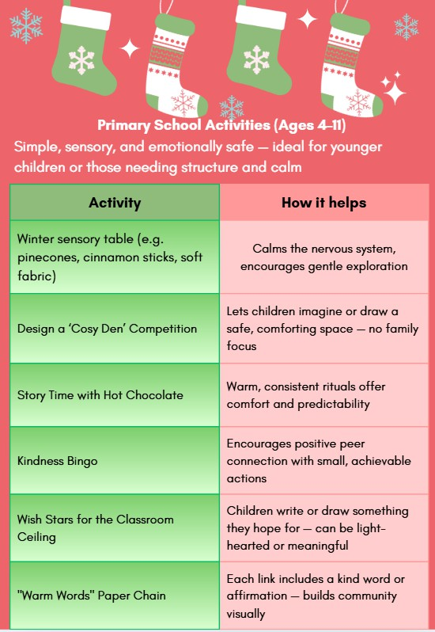
Christmas in the classroom 3

Slide 24
Secondary school activities
SECONDARY SCHOOL ACTIVITIES
(AGES 11-18)
"Design Your Own Celebration" Brief
Encourages individuality and creativity -
students invent a holiday with their own values, foods, and traditions
'Hope Board' or Graffiti Wall“
Things I’m looking forward to next year"
Shifts focus to the future; builds agency and optimism
Create a 'Winter Playlist' Together
Students contribute songs that feel calming or meaningful - builds connection without emotional exposure
'Small Joys' Photography Project
Use phone cameras to capture things that make them smile (a pet, a snack, sunlight on a window) -- builds mindfulness
Mindful Letter to Your Future Self
Private writing activity that encourages reflection and self-compassion
Positive Post-It Exchange
Students anonymously leave encouraging notes for others - low pressure, peer-led
Provides a calm, low-pressure space for students who prefer quieter environments offering creative outlets like journaling or crafts as a way to self-regulate, reflect, or simply take a break from busier festive activities.
Drop-In Creative Space at Break Times

Slide 25


Secondary school activities
Trauma-Informed Principles Behind These Activities
Choice: Opt-in, not forced. Always ensure participation is optional. Offer opt-out spaces during assemblies, shows or parties.
Connection: Builds peer or adult relationships without being intrusive.
Creativity: Encourages expression without personal disclosure.
Calm: Helps regulate nervous systems overstimulated by festive energy.
Inclusivity: No assumptions about family, religion, or home life.
Speaking Gently this Season: Language to Reframe or Avoid
The language we use can either create connection or deepen isolation. Here's how to gently reframe common school phrases:
Sensitivity doesn’t cost us anything — but it can protect a child’s dignity and wellbeing.
Sensitivity doesn’t cost us anything — but it can protect a child’s dignity and wellbeing.
Instead of… | Try saying…
“What are you doing with your family for Christmas?” | “Is there anything you’re looking forward to over the holidays?”
“Write about your family’s Christmas traditions” | “Write about something that feels special or comforting to you”
“Bring in a photo of your family” | “Bring something that makes you feel proud or happy”
“Let’s make cards for Mum and Dad” | “Make a card for someone important to you”
“Everyone should wear their Christmas jumper!” | “Wear a festive jumper if you’d like to take part”
“What did Santa bring you?” | “Did you have a moment over the holidays that made you smile?”
Key Message:
Sensitivity doesn’t cost us anything — but it can protect a child’s dignity and wellbeing.

Slide 26

Secondary school activities 2
Being a Safe Adult During the Festive Season
You may not always know which children are in care, or which students find this time of year difficult. It's safest to assume that any class may include children with painful or complex associations around Christmas. A gentle, flexible approach can make all the difference.
If you’re unsure how best to support a particular student, speak to your school’s Designated Teacher
for children in care or another safeguarding lead.
For many care-experienced children, school staff are among the most consistent and trusted adults in their lives. Small things — a warm word, a predictable routine, or a moment of quiet understanding — can leave a lasting impact long after the holidays are over.

Slide 27
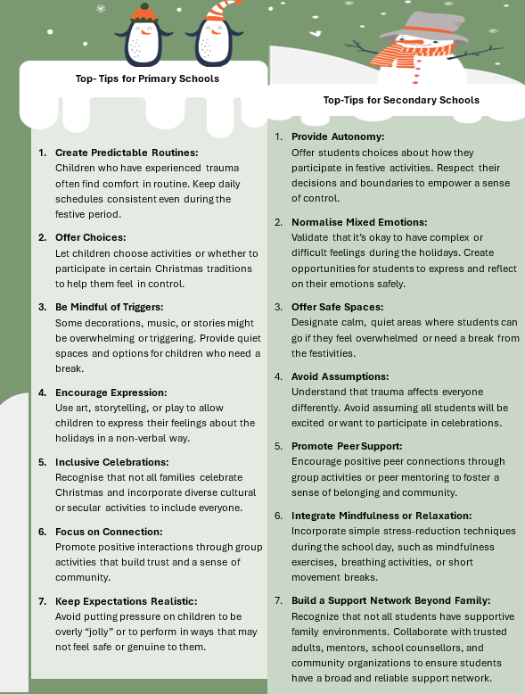
Secondary school activities3
Being a Safe Adult During the Festive Season

Slide 28

Secondary school activities 4
Final Thoughts
The Christmas season can stir up a complex mix of emotions for children in care — joy, grief, uncertainty, loneliness, or even pressure to appear “festive” when they may be struggling inside. While the holidays are often framed as a time of togetherness and tradition, it’s important to remember that not all children experience the season that way.
For some, Christmas can feel like a painful spotlight — highlighting what’s missing rather than what’s present. But schools can be places where belonging, warmth, and safety shine through. A trauma- informed approach isn’t about removing celebration; it’s about widening the circle, so every child can participate in ways that feel safe and meaningful to them.
As educators and trusted adults, we can’t change a child’s history — but we can shape their experience in the present. Small shifts in our language, our expectations, and our activities can make a big difference in how a child feels at school during this time.
You don’t have to fix everything.
But by being trauma-informed, you can make sure no child feels forgotten.
And sometimes, that’s more powerful than you’ll ever know.
"The best gift we can offer is presence, care, and a sense of belonging — for every child."

Slide 29
Secondary school activities 5
Further Resources and Support
https://beaconhouse.org.uk/resources/ (see Winter Resources) A Trauma Informed Approach to Christmas
UK Trauma Council PACE at Christmas Bereavement:
Free Online Bereavement Training for Schools | Winston's Wish Traumatic Bereavement Resources for Schools and Colleges | Anna Freud Sensory:
Managing Christmas Sensory Challenges
Christmas Sensory Survival Kit (sign up for free sensory survival kit) Social Stories:
Free Christmas Social Stories | And Next Comes L – Hyperlexia
Resources Book:
The Very Wobbly Christmas: A story to help children who feel anxious about
Christmas: Amazon.co.uk Naish, Sarah, Jefferies, Rosie: 9781726626729: Books

Slide 30

Safeguarding Update

Slide 31
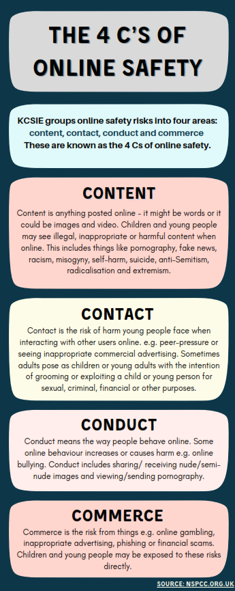


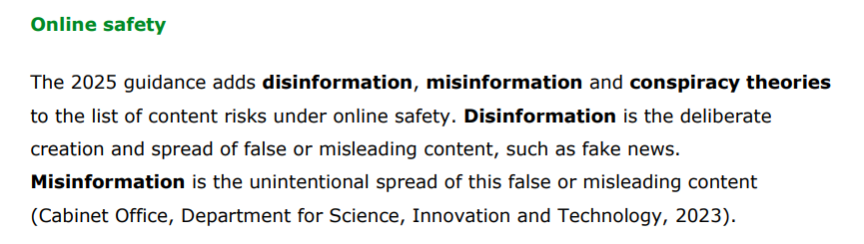
Fake News, Misinformation and Disinformation
Fake News, Misinformation
and Disinformation

Slide 32

Fake News, Misinformation and Disinformation
Fake News, Misinformation and Disinformation-
What Schools Need to Know
In today’s digital world, young people are bombarded with information every time they go online - but not all of it is true. Some content is simply inaccurate, some is deliberately misleading, and some is designed to cause harm. For educators and parents, understanding the difference and helping children to do the same is an essential part of safeguarding.
Fake News, Misinformation and Disinformation - What Schools Need to Know | Safeguarding Network

Slide 33
Fake News, Misinformation and Disinformation 2
Fake News, Misinformation and Disinformation
What’s the Difference?
Disinformation: False information created on purpose to mislead, often by individuals or groups pushing an agenda.
Misinformation: False information that is shared without intent to mislead.
Fake news: A broad, popular term often used to describe either of the above when dressed up as credible reporting.
Fake News, Misinformation and Disinformation - What Schools Need to Know | Safeguarding Network

Slide 34
Fake News, Misinformation and Disinformation 3
Fake News, Misinformation and Disinformation
Why It Matters
These aren’t just harmless rumours. Disinformation and misinformation can:
Spread hatred, intolerance or conspiracy theories.
Influence vulnerable young people.
Cause distress or confusion when presented as fact.
Undermine trust in genuine information sources.
Extremist groups use false narratives online to try to radicalise or manipulate young audiences.
Fake News, Misinformation and Disinformation - What Schools Need to Know | Safeguarding Network

Slide 35
Fake News, Misinformation and Disinformation 4
Fake News, Misinformation and Disinformation
Risks for Children and Young People
They may believe false content and repeat it as truth.
They may encounter extremist or hateful material online.
They may feel upset or unsafe when exposed to shocking or misleading claims.
Many do not have the skills or confidence to challenge what they see.
Fake News, Misinformation and Disinformation - What Schools Need to Know | Safeguarding Network

Slide 36
Fake News, Misinformation and Disinformation 5
What Schools Can Do
Safeguarding in the digital age means building students’ media literacy from the earliest age.
Teach critical thinking such as how to spot bias, fact-check, and question credibility.
Embed into curriculum. Use RSHE, Citizenship, or ICT lessons to address online safety and digital resilience.
Signpost resources with programmes like Be Internet Citizens, Be Internet Legends, and NSPCC’s Trust Me provide practical activities.
Create safe spaces and encourage children to talk about what they see online and support them if they feel upset or unsure.
Helping children recognise fake news isn’t about turning them into sceptics. It’s about equipping them, giving them the tools to be thoughtful, safe, and resilient digital citizens. By tackling misinformation head-on, schools can empower pupils to make sense of the online world and protect them from the risks of harmful narratives.
Fake News, Misinformation and Disinformation - What Schools Need to Know | Safeguarding Network

Slide 37

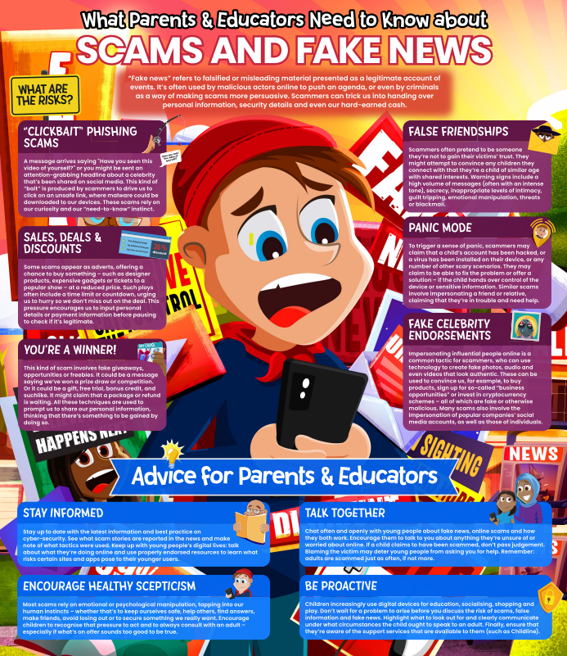
Fake News, Misinformation and Disinformation 6
Free Webinar: Detecting Deception: Guiding Pupils through Scams and False Information Online
Scams & False Information Online | Primary
Scams & False Information Online | Secondary
What You Need to Know about Fake News & Scams | Free Guide
PDF Guide for professionals and parents/carers
Educate Against Hate article can be found here.
Safeguarding Network materials on Online Safety can be found here.

Slide 38
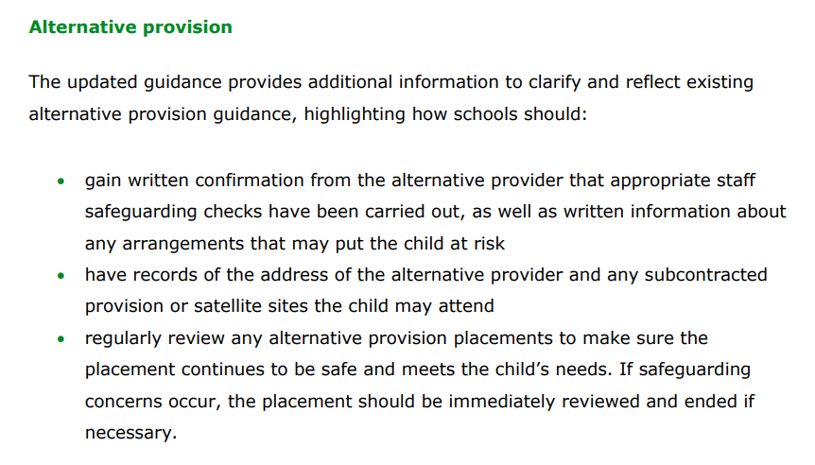
xxxx

Slide 39

Fake News, Misinformation and Disinformation 7
DfE Arranging Alternative Provision; A Guide for Local Authorities and Schools, Feb 2025- P16 and 17
Safeguarding
Where a child is placed in alternative provision, the commissioning school or local authority continues to retain safeguarding duties towards the child and should therefore be satisfied that the provision is in a safe environment as well as meeting the child’s pastoral and educational needs.
Commissioners should obtain written confirmation from the alternative provider that appropriate safeguarding checks have been carried out on individuals working at the establishment, i.e. those checks that schools would otherwise perform in respect of their own staff. This includes written confirmation that the alternative provision provider will inform the commissioner of any changes to arrangements that may put the child at risk, e.g. staff changes, so that the commissioner can assure itself that appropriate safeguarding checks have been carried out on new staff.
STATUTORY

Slide 40
Fake News, Misinformation and Disinformation 8
KCSIE 2025; Alternative Provision- P16 and 17 CONTINUED
When a child is attending an alternative provision school, the commissioner should ensure that they have arrangements in place whereby all absence is followed up promptly, particularly unexpected and unexplained absence. When a child is placed in a college or unregistered alternative provision setting, the commissioner should also ensure that they have arrangements in place whereby the provider of the educational activity notifies them of any absences by the child. The commissioner should always know where the child is during school hours. This includes having records of the actual address of the commissioned alternative provider and any subcontracted provision or satellite sites the child may attend.
Commissioners should regularly review placements they make in alternative provision. Reviews should be frequent enough (at least half-termly) to assure that the provision is achieving its objectives, that the child is regularly attending and that the placement continues to be safe and meets the child’s needs. Where safeguarding concerns arise, the placement should be immediately reviewed and terminated if necessary, unless or until those concerns have been satisfactorily addressed.

Slide 41
Using AP for our CLA young people
As soon as you are considering using AP for a CLA young person, inform the Virtual School by contacting your Learning Advocate
Continue to keep your VS LA updated on the use of AP, ensuring they are aware of any changes made to the original plan
Ensure feedback from the AP is contributing to the PEP document and meeting discussions; pastoral update, how the young person presents (SEMH), attendance, behaviour etc.
You could consider inviting a representative from the AP to the PEP
Upload any reports/updates you have received from the AP to the documents section of the PEP

Slide 42
PEP updates
Overtyping
Save & submit
Notifications
LCS
PTTT
PEP Updates

Slide 43


Q and A

