Slide 1

Designated Teacher Updates and Guidance Session Spring 2026

Slide 2
Agenda
Transition Support – Rachel Reed, WVS Learning Advocate
SEND update (SEND White Paper)– Mary Williams, WVS SEND Lead
Safeguarding update – Rachel Reed, WVS Learning Advocate
Language that Cares; writing the PEP to the child/young person – Kerry Lawrence, VSDHT
PEP updates, notices and questions – Rachel Reed, WVS Learning Advocate

Slide 3

Transition Guidance Supporting successful school transitions for vulnerable pupils Rachel Reed Learning Advocate – Worcestershire Virtual School

Slide 4


Transition Guidance
Virtual School useful links to guidance and resources | Worcestershire County Council
Aim: ensure young people feel safe, supported and able to thrive in their new setting.
1_WVS Transition- Guidance for Designated Teachers
Produced by Worcestershire Virtual School to support practitioners.
Focuses on transitions for Children Looked After (CLA), Previously Looked After Children (PLAC) and Children with a Social Worker (CWSW).
Transitions (e.g., primary to secondary or school moves) can be particularly challenging for children who have experienced trauma.
Notes:
This guidance has been produced by Worcestershire Virtual School to support professionals working with vulnerable young people during school transitions.
It specifically focuses on Children Looked After, Previously Looked After Children, and children who have a social worker, who may face additional challenges during educational transitions.
Moving schools, particularly from primary to secondary, can be a major change.
The aim of this guidance is to help schools and professionals plan transitions carefully so young people feel safe, supported and able to succeed in their new environment.

Slide 5
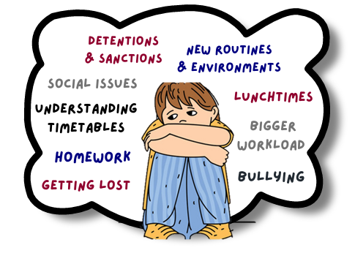
Why Transitions Can Be Difficult
Why Transitions Can Be Difficult
Impact of change on vulnerable young people
Moving schools can trigger feelings of instability, anxiety and loss.
Trauma can lead to heightened stress responses (fight, flight, freeze).
Anxiety may appear through behaviour rather than words.
Emotional stress can affect:
Classroom engagement
Behaviour
Academic performance
Notes:
Transitions can be unsettling for any young person because they involve new environments, routines, expectations, and relationships.
For children who have experienced trauma or instability, these changes may trigger feelings of anxiety, insecurity or loss.
Anxiety may not always be expressed verbally. Instead, it may appear through behaviour such as withdrawal, frustration, or difficulty concentrating.
When young people feel overwhelmed, their brain may activate fight, flight or freeze responses, which can affect behaviour and learning in school.
By understanding these worries, schools can put targeted support in place, such as additional visits, buddy systems, clear explanations of routines, and opportunities for pupils to ask questions before the transition.

Slide 6
What Research Shows
What Research Shows
Key findings about school transitions
Children in care often need extra support with social and emotional adjustment.
Anxiety and trauma may reduce resilience and coping strategies.
High anxiety can impact learning and concentration.
Children in care are more likely to experience bullying.
Positive language and peer relationships can significantly improve outcomes.
Notes:
The impact of the language we use: Language used by teachers around transitions can heighten anxiety for children in care (Jindal-Snape & Cantali, 2019) Bagnall et al. (2020). Throughout the period of transition, all professionals should be realistic, yet positive about future experiences for example the use of language around increased expectations at Secondary School may be used by primary staff but the impact of this could be to increase anxiety and should be done sensitively. The importance of friendships and peer support: Research by Ng-Knight et al. (2018) states that friendships have a direct impact on school attainment and positive behaviours Transition disrupts social networks, impacting academic focus and well-being. Strong peer relationships buffer anxiety (Evans et al., 2018), while peer acceptance predicts academic success (Keay et al., 2015).

Slide 7
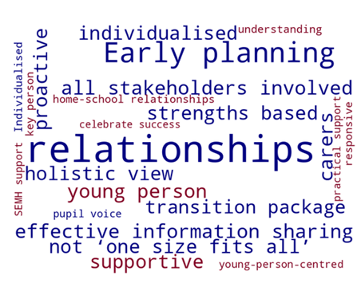
Transition Planning
Transition Planning
Key principles for supporting pupils
Transition support should be personalised to each young person.
Focus on:
Building relationships and peer connections
Developing confidence and resilience
Supporting emotional regulation and executive functioning.
Work collaboratively with:
Carers
Social workers
Designated Teachers
Pastoral staff
Virtual School staff
Notes:
Effective transition planning should be individualised, recognising each young person’s unique experiences and needs.
Building strong relationships is key. Young people need trusted adults and opportunities to form new peer connections.
Transition support should also focus on developing resilience, confidence, and emotional regulation skills, helping pupils manage stress and change.
Collaboration is essential. This involves carers, social workers, designated teachers, pastoral teams and the Virtual School, all working together to support the young person.

Slide 8
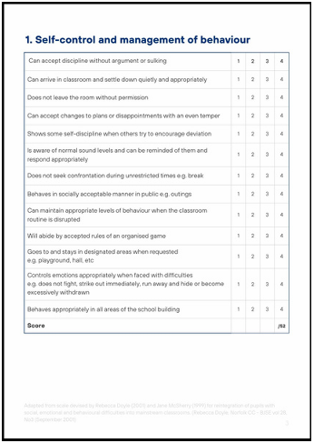

Readiness for Transition
Readiness assessment considers:
1. Self-control and management of behaviour
2. Social skills
3. Self-awareness and confidence
4. Skills for learning
5. Approach to learning
Transition Planning Meeting
Preparing pupils
Preparing parents/carers
Preparing receiving staff
Arrangements for arrival
Transition timetable
WVS Transition Readiness Scale
Notes:
This readiness scale is based on materials devised by Rebecca Doyle (2001) and Jane McSherry (1999) adapted for CLA.
The guidance also highlights the importance of assessing a pupil’s readiness for transition.
This assessment looks at 5 areas such as behaviour management, social skills, confidence, skills for learning and approaches to learning.
Create profile of relative strength and further development, used to inform planning for transition

Slide 9
Timeline for Transition
Timeline for Transition
Suggested transition timeline (Y6-Y7):
Starts Year 5 (Summer term)) with early planning. – EHCP Annual Review, EP advice, research settings, assessment of transition readiness and profile of need, pupil voice
Continues through Year 6 and included range of transition activities
Autumn - attend open evenings, phase transfer application, transition plan, pupil voice, use of PP+ funds
Spring – review transition plan, WVS EP drop-in, pupil voice, PP+
Summer – contact with setting, share key dates (PEP/CLA review), receiving school DT to attend Summer Term PEP, update assessment of transition readiness, extra visits, pupil voice, and personalised support.
Reviewed in Year 7 - PEP meetings to monitor progress – transition PEP with 20 days, information sharing with carers, pastoral support from key person, review transition plan, pupil voice, Pupil Profile shared with staff
Notes:
The guidance also highlights the importance of assessing a pupil’s readiness for transition.
This assessment looks at areas such as behaviour management, social skills, confidence, and approaches to learning.

Slide 10

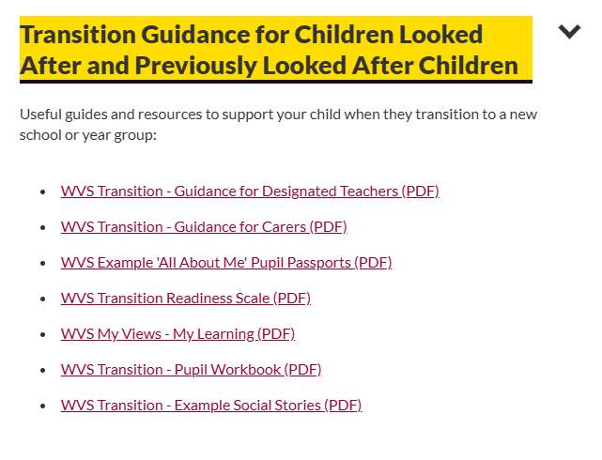
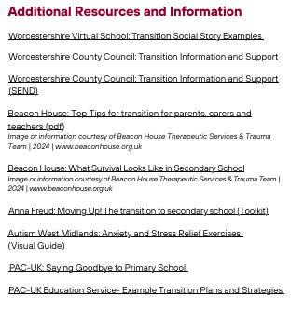
Useful Resources
WCC Transition support , including EYFS, parent support and transition resources:
Transition | Worcestershire County Council
Virtual School useful links to guidance and resources | Worcestershire County Council

Slide 11
Key Takeaways for Supporting Successful Transitions
Transitions can be particularly challenging for Children Looked After (CLA), Previously Looked After Children (PLAC) and those with a social worker.
Trauma and anxiety can influence behaviour, learning and emotional responses during periods of change.
Early planning and personalised transition support are essential for positive outcomes.
Listening to pupil voice helps identify worries and ensures support reflects the young person’s needs.
Strong collaboration between professionals, carers and schools is key to ensuring a smooth transition.
The ultimate goal is to help young people feel safe, confident and ready to succeed in their new school environment.
Notes:
To conclude, transitions are a significant moment in a young person’s educational journey. While they can be exciting, they can also bring uncertainty and anxiety, particularly for children who have experienced trauma or instability.
By planning early, listening to the young person’s voice, and working collaboratively with carers, social workers and school staff, we can create a transition process that feels structured, supportive and predictable.
Ultimately, our role is to ensure that every young person feels safe, understood and confident as they move into the next stage of their education, giving them the best opportunity to succeed and thrive.

Slide 12
SEND Update Mary Williams Learning Advocate –SEND lead Worcestershire Virtual School

Slide 13

DfE SEND reforms – White Paper
DfE SEND reforms – White Paper
What is a White paper?
White papers are policy documents produced by the Government that set out their proposals for future legislation. This provides a basis for further consultation and discussion with interested or affected groups and allows final changes to be made before a Bill is formally presented to Parliament.

Slide 14

White Paper on SEND reform 23/02/2026
White Paper on SEND reform 23/02/2026
Every Child Achieving
and Thriving
Every Child Achieving and Thriving
120 pages long

Slide 15

Experts at Hand
Expanding access to multiagency support in mainstream creating a new Experts at Hand service of speech and language therapists, Educational Psychologists and wider professionals to get support to children early.

Slide 16
Support will be organised across two additional layers of support
Targeted (including Targeted Plus) will provide structured, evidence-based interventions within mainstream schools, drawing on the Experts at Hand service to involve education, health and care professionals, where needed.
The Specialist layer will provide a higher level of provision for children with complex needs, through new Specialist Provision Packages, which will form the basis of EHCPs.
For every child receiving Targeted or Specialist support, regardless of their educational setting, schools will be required to develop an Individual Support Plan. This plan will describe the child’s day-to-day educational provision and the support required and will be created collaboratively with parents.

Slide 17
Code Of Practice
We will update the SEND Code of Practice to clarify the responsibilities of education settings and local partners, as well as make the guidance easier to use and navigate. In this update, we will place a stronger emphasis on an evidence-based, “support first” approach as part of a whole-setting commitment to inclusion. The National Inclusion Standards will provide a clear framework for how the updated Code should be delivered in practice.

Slide 18
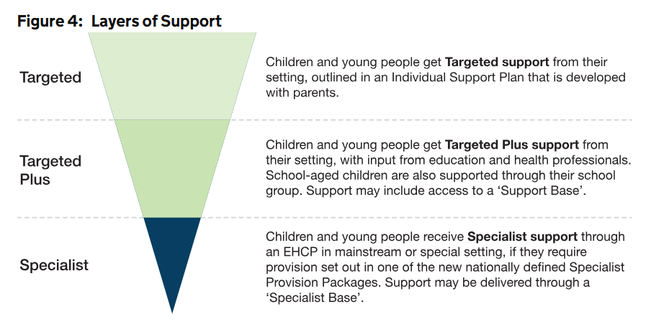
Layers of support

Slide 19
Safeguarding Update Sadie Holloway Learning Advocate –DSL Worcestershire Virtual School

Slide 20

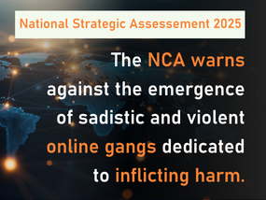
The rising threat of ‘Com Networks’
Online collectives of individuals who work together or compete on chat platforms to cause harm and commit crimes. They do this to make money, gain notoriety and/or to promote their ideologies.
Offenders collaborate or compete to cause harm across a broad spectrum of criminality - both on and offline - including cyber, fraud, extremism, serious violence, and child sexual abuse.
Offenders groom, coerce and blackmail victims to encourage:
Self harm and suicide
Sexual exploitation- degradation and humiliation
Terrorism and mass violence
Hazing/physical attacks
Animal abuse
Arson
Much of which is live streamed and shared.

Slide 21




The rising threat of ‘Com Networks’ 2
Offenders operate on various online platforms- Clear Web, Discord, Telegram, Signal. Favoured for their lack of monitoring and safeguarding features.
But contact with victims can also start out on ROBLOX, Minecraft, Snapchat, Instagram etc. where vulnerable young people can be targeted.
Sadly, safe spaces such as mental health forums are also used to look for vulnerable victims.

Slide 22
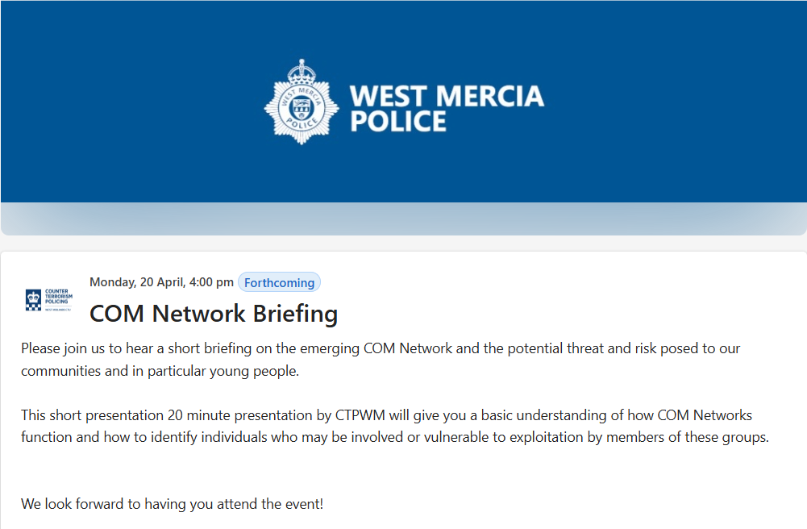
WM Police ‘Com Network’ Briefings

Slide 23

Get Safe Training and Support
Safeguarding Children, young people and vulnerable adults is everybody’s responsibility. This raising awareness of exploitation & vulnerability course aims to raise your awareness of: Vulnerability,
adverse childhood experiences, organised crime groups/gangs; Modern day slavery, consent for sexual activity; Child Sexual Exploitation (CSE), criminal exploitation; Appropriate language and use of; National referral mechanism; GDPR/disclosure and Pathways/ diversionary/sharing of intelligence.
Cost: Free to all schools, DSL and DDSLs to attend

Slide 24
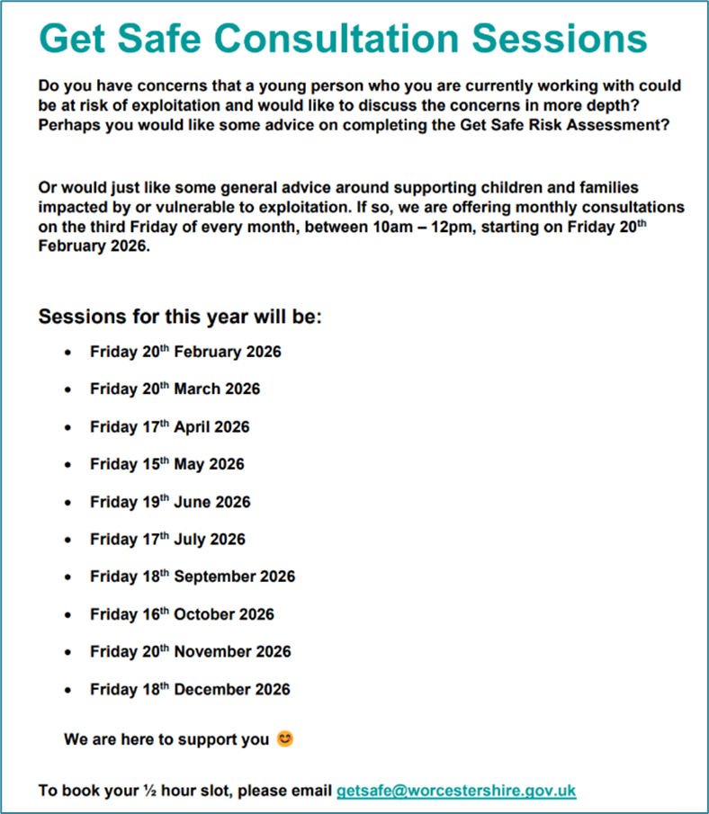

Get Safe consultation sessions

Slide 25


Training Opportunity
Promoting positive masculinity,
self-worth & relationships *NEW*
In the training, we cover what constitutes positive masculinity, and how it is related to feelings of self-worth. We will explore the psychological theory underpinning self- worth, how this is related to the concept of masculinity and impacts relationships. We will discuss how we change the narrative from 'toxic' to 'positive' masculinity and the scaffolding needed to enable boys and young men to flourish by looking at targeted and universal approaches.
Cost: Free
01 July 2026, 3.30pm to 5pm, virtual delivery
course code: 10596 / 91859

Slide 26
Child Friendly Recording
Who is the PEP for?
Guidance for writing PEP records that children and young people can understand.
Kerry Lawrence
Deputy Headteacher - Worcestershire Virtual School

Slide 27
What is Child Friendly Recording?
Writing a child or young person’s file to them.
When they are 18 years old, they will have the right to access their file and read what was written about them. The file should reflect their journey throughout their involvement with Children’s Social Care.
Child/Young Person Friendly Recording is when records are written directly to the child/young person and will be easily understood when they come to read information about themselves at a later date.

Slide 28
Why Child Friendly Recording Matters
Why Child Friendly Recording Matters
This is the child/young person’s story of what has happened and why. It is important to capture their voice to reflect their wishes and feelings, experiences and perspectives. For some children/ young people a written record will be the only resource they have to learn about their childhood and to understand decisions made with them and about them.
If a child/young person wants to look at, read, and understand their social work record it should be easily understood, accessible and reflect their experiences.
Good recording supports good decision-making for children and families and allows professionals to be accountable for their work.

Slide 29
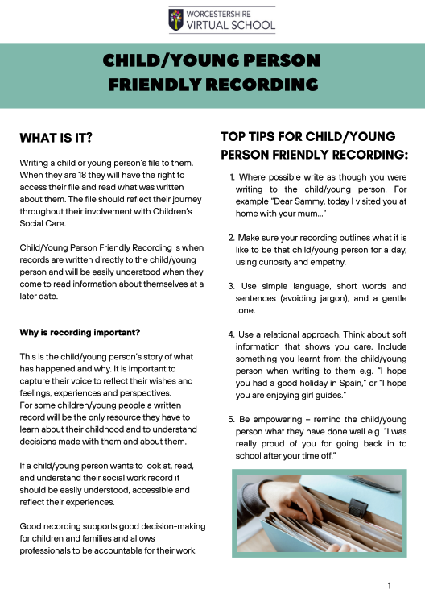
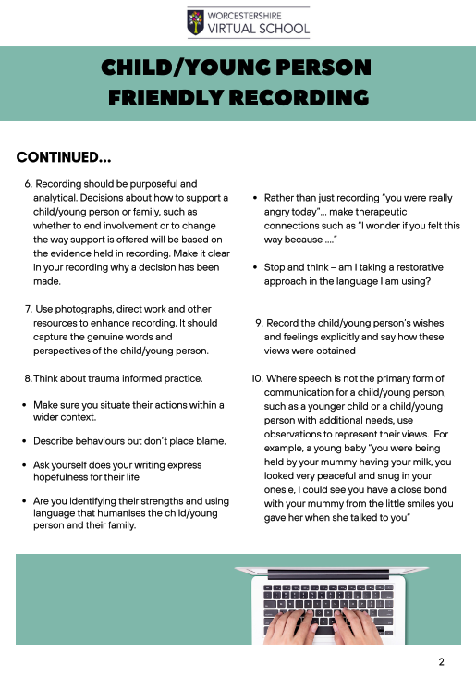
Child/young person friendly recording

Slide 30
Check: Before You Write in a PEP
Before recording information about a child or young person, ask yourself:
1. Would I feel comfortable if the child read this when they are 18?
2. Does this language show respect, care, and understanding?
3. Am I describing behaviour rather than labelling the child?
4. Have I included the child’s voice, wishes, or feelings?
5. Does my writing recognise the child’s strengths as well as their challenges?
6. Does this reflect hope for the child’s future learning and development?

Slide 31
Implications for DTs when writing PEPs
Every PEP entry contributes to the child’s story. The way we write about children should reflect care, respect, and belief in their potential.
Trial use of Language that Cares now to get used to writing in this style
To become part of QA process from Sept 2026

Slide 32
Kerry Lawrence
Kerry Lawrence
Deputy Head Virtual School
Tel: 07534 098035
Email: klawrence5@worcestershire.gov.uk

Slide 33
PEP updates, WVS notices, Any questions? Rachel Reed Learning Advocate – Worcestershire Virtual School

Slide 34
Virtual School /PEP Updates
Overtyping - please do not overtype as information gets lost, use x + to insert new row
Save & submit – PEP information should be available before the meeting, submitted shortly after the meeting.
SEND – SEND support/EHCP review dates, interventions (updated termly) and attach SEND documents
Suspensions – all suspensions should be shared with the Virtual School immediately, and official letters and reintegration plans provided to Learning Advocate. PEP document to include exclusion this academic year.
PTTT – notify WVS Leaning Advocate and agreed by SW, WCC via Children’s Services Portal, a reintegration plan reviewed fortnightly
Quality Assurance – new criteria from Sept 26 to include Language that Cares
Virtual School /PEP Updates

Slide 35

Worcestershire Virtual School is pleased to share an exciting opportunity available to Children Looked After and Previously Looked After young people aged 8–16 years.
This event has now been rescheduled, and we truly hope you’ll be able to join us on the new date and time.
Worcestershire Virtual School is pleased to share an exciting opportunity available to Children Looked After and Previously Looked After young people aged 8–16 years.
We have partnered with Worcestershire Martial Arts to offer a
free, introductory martial arts session designed to build:
Discipline
Focus
Self‑control
Fitness
Confidence
Perseverance
And many other positive skills that support wellbeing and education.
This will be a supportive, beginner‑friendly session that encourages young
people to try something new in a safe, structured environment.
📅 Session Details 📆 Date: Thursday 9th April ⏰ Time: 12.00-13.00 📍 Location: Worcestershire Martial Arts, Trading Estate, 3 Checketts Lane, Worcester, WR3 7JW 👥 Spaces: Up to 20 places — early booking recommended 🌐 Venue website: https://www.worcestershiremartialarts.co.uk/ Parents/ Carers do not need to remain for the session, but are welcome to drop-off and collect. | Who is this for? This opportunity is open to: Children Looked After (CLA) Previously Looked After Children (PLAC) aged 8–16 years who may benefit from a confidence‑boosting, physical, and engaging activity. | How to book To secure a place complete the booking form via this link: Worcestershire Martial arts introduction session - 9th April 2026 – Fill in form The deadline for bookings is Friday 20th March 2026. Places will be allocated on a first‑come, first‑served basis.

Slide 36

Celebrating World Book Day & World Theatre Day
Dear children, young people, carers, and schools,
To mark both World Book Day and World Theatre Day, Worcestershire Virtual School is excited to launch a creative, inclusive, and imagination‑filled activity for children and young people of all ages (Children Looked After and Previously Looked After)
We are being supported by Malvern Theatre,- please watch the videos below from Toby and Zoe, as they outline the challenge and share some tips and tricks to support you. Launch video: https://youtu.be/EKrNH9MUgeQ
Top Tricks to support your character creation: https://youtu.be/HLoAgwo6ls4
🌟 Your Challenge: Create a Character! We’re inviting you to design your very own original theatre character and bring them to life through a character profile. This celebration embraces storytelling, performance, art, and creativity in all its forms.
There is no right or wrong way to take part—this activity is designed so every child and young person can join in, no matter their age, ability, or creative style.
❤️ We Can’t Wait to Meet Your Characters
1. Invent Your Character | 2. Create a Character Profile | 3. Optional Extras
Your character can be: • A human • An animal • A mythical being • Something completely abstract or magical Anything your imagination dreams up! | Include fun details like: • Name & appearance – What do they look like? Do they have a costume? • Personality – Are they brave, shy, mischievous, kind? • Backstory – Where are they from? What matters to them? • Special talent or secret – Something unique that makes them stand out | You can also choose to: • Draw or paint your character • Write a monologue or short scene • Record a short performance as your character (if you want to!)

Slide 37
Designated Teacher Updates and Guidance Session Summer 2026 Tuesday 7th July @ 1.30 or 3.30pm
Any requests for any key issues/themes that DTs would welcome in next session, please let me or your Learning Advocate know.
Rachel Reed – rreed@worcestershire.gov.uk

Slide 38


Q and A

Slide 39

Thank you

